Slide 1



UNIT 4
LESSON 13
Living online
Part 3

Slide 2
It’s used all over the world.
It’s not as expensive as it used to be.
It’s very useful.
It’s made of plastic.
It can be used both indoors and outdoors.
If you have one, you can contact anyone around the world at any moment.
You need to learn how to use it.
If you have one, you don’t need newspapers or books.
It’s used to do business but also for fun.
Its basic parts are chips.
It’s a COMPUTER!

Slide 3
Which names do you associate with computers?
Bill Gates
Steve Jobs
How are they related to computers?
YES/NO QUESTIONS
Do you...
Have you got...
Are you...
Were you...
Have you...
Can you...
Will you...
Does your...
Do your...
WH-QUESTIONS
What…
Where…
When…
How…
Why…
Which…
Whose…

Slide 4
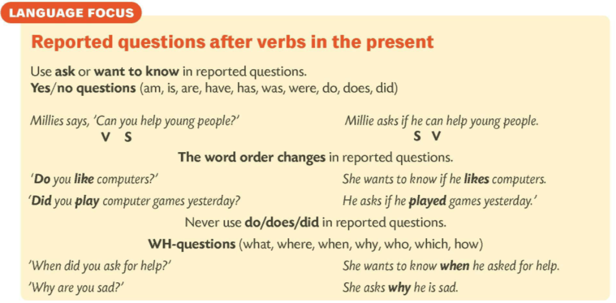
Is Bill Gates married? → Who wants to know if Bill Gates is married?
When was he born? → Who wants to know when he was born?
etc.

Slide 5


She wants to know does he live in Mexico.
She wants to know if he lives in Mexico.
He asks if he was born in 1955.
over/tries/permission/someone/to/who/secure/the/get/
without/Internet/information
The teacher wants to know why is she is late.
Someone who tries to get secure information over the Internet without permission.
The teacher wants to know why she is late.
A HACKER

Slide 6
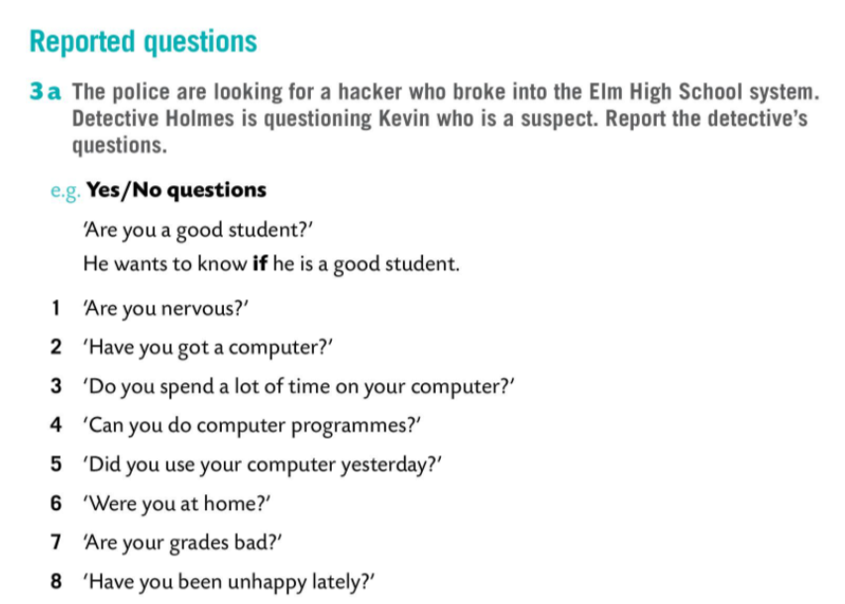
Kevin, a boy who attends Elm High School has a problem. Detective Holmes is questioning him.
A hacker broke into the Elm High School. Kevin is a suspect.

Slide 7
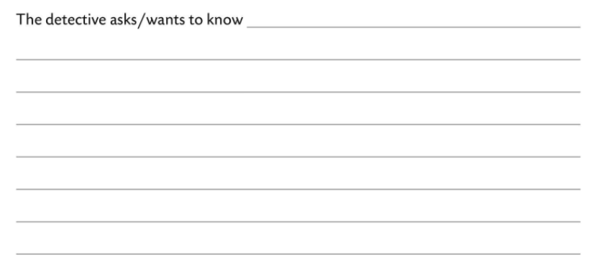
if he is nervous.
The detective asks / wants to know if he has got a computer.
The detective asks / wants to know if he spends a lot of time on his computer.
The detective asks / wants to know if he can make computer programmes.
The detective asks / wants to know if he used his computer yesterday.
The detective asks / wants to know if he was at home.
The detective asks / wants to know if his grades are bad.
The detective asks / wants to know if he has been unhappy lately.

Slide 8
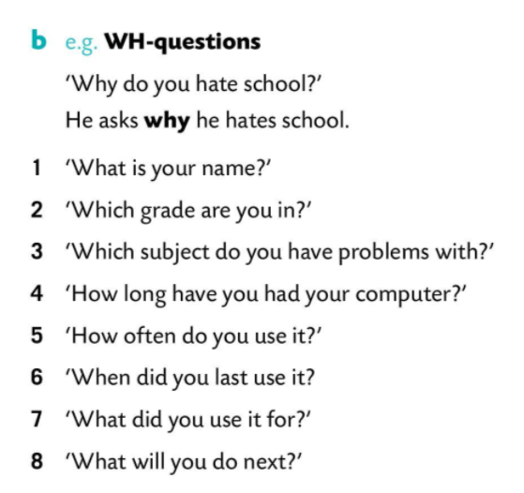

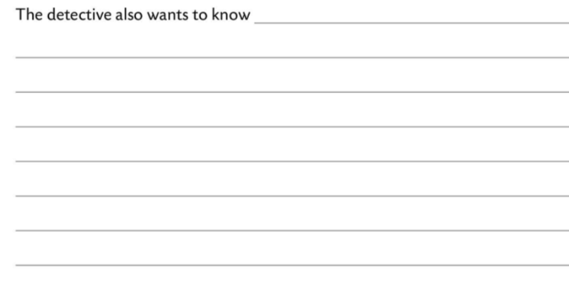
what his name is.
He wants to know which grade he is in.
He wants to know which subjects he has problems with.
He wants to know how long he has had his computer.
He wants to know how often he uses it.
He wants to know when he last used it.
He wants to know what he used it for.
He wants to know what he will do next.

